Slide 1
KPB School And College
Kadamtola, Bashaboo, Dhaka-1214
Mobile: 01632000008
E-mail: kpbsc1133@gmail.com

Slide 2
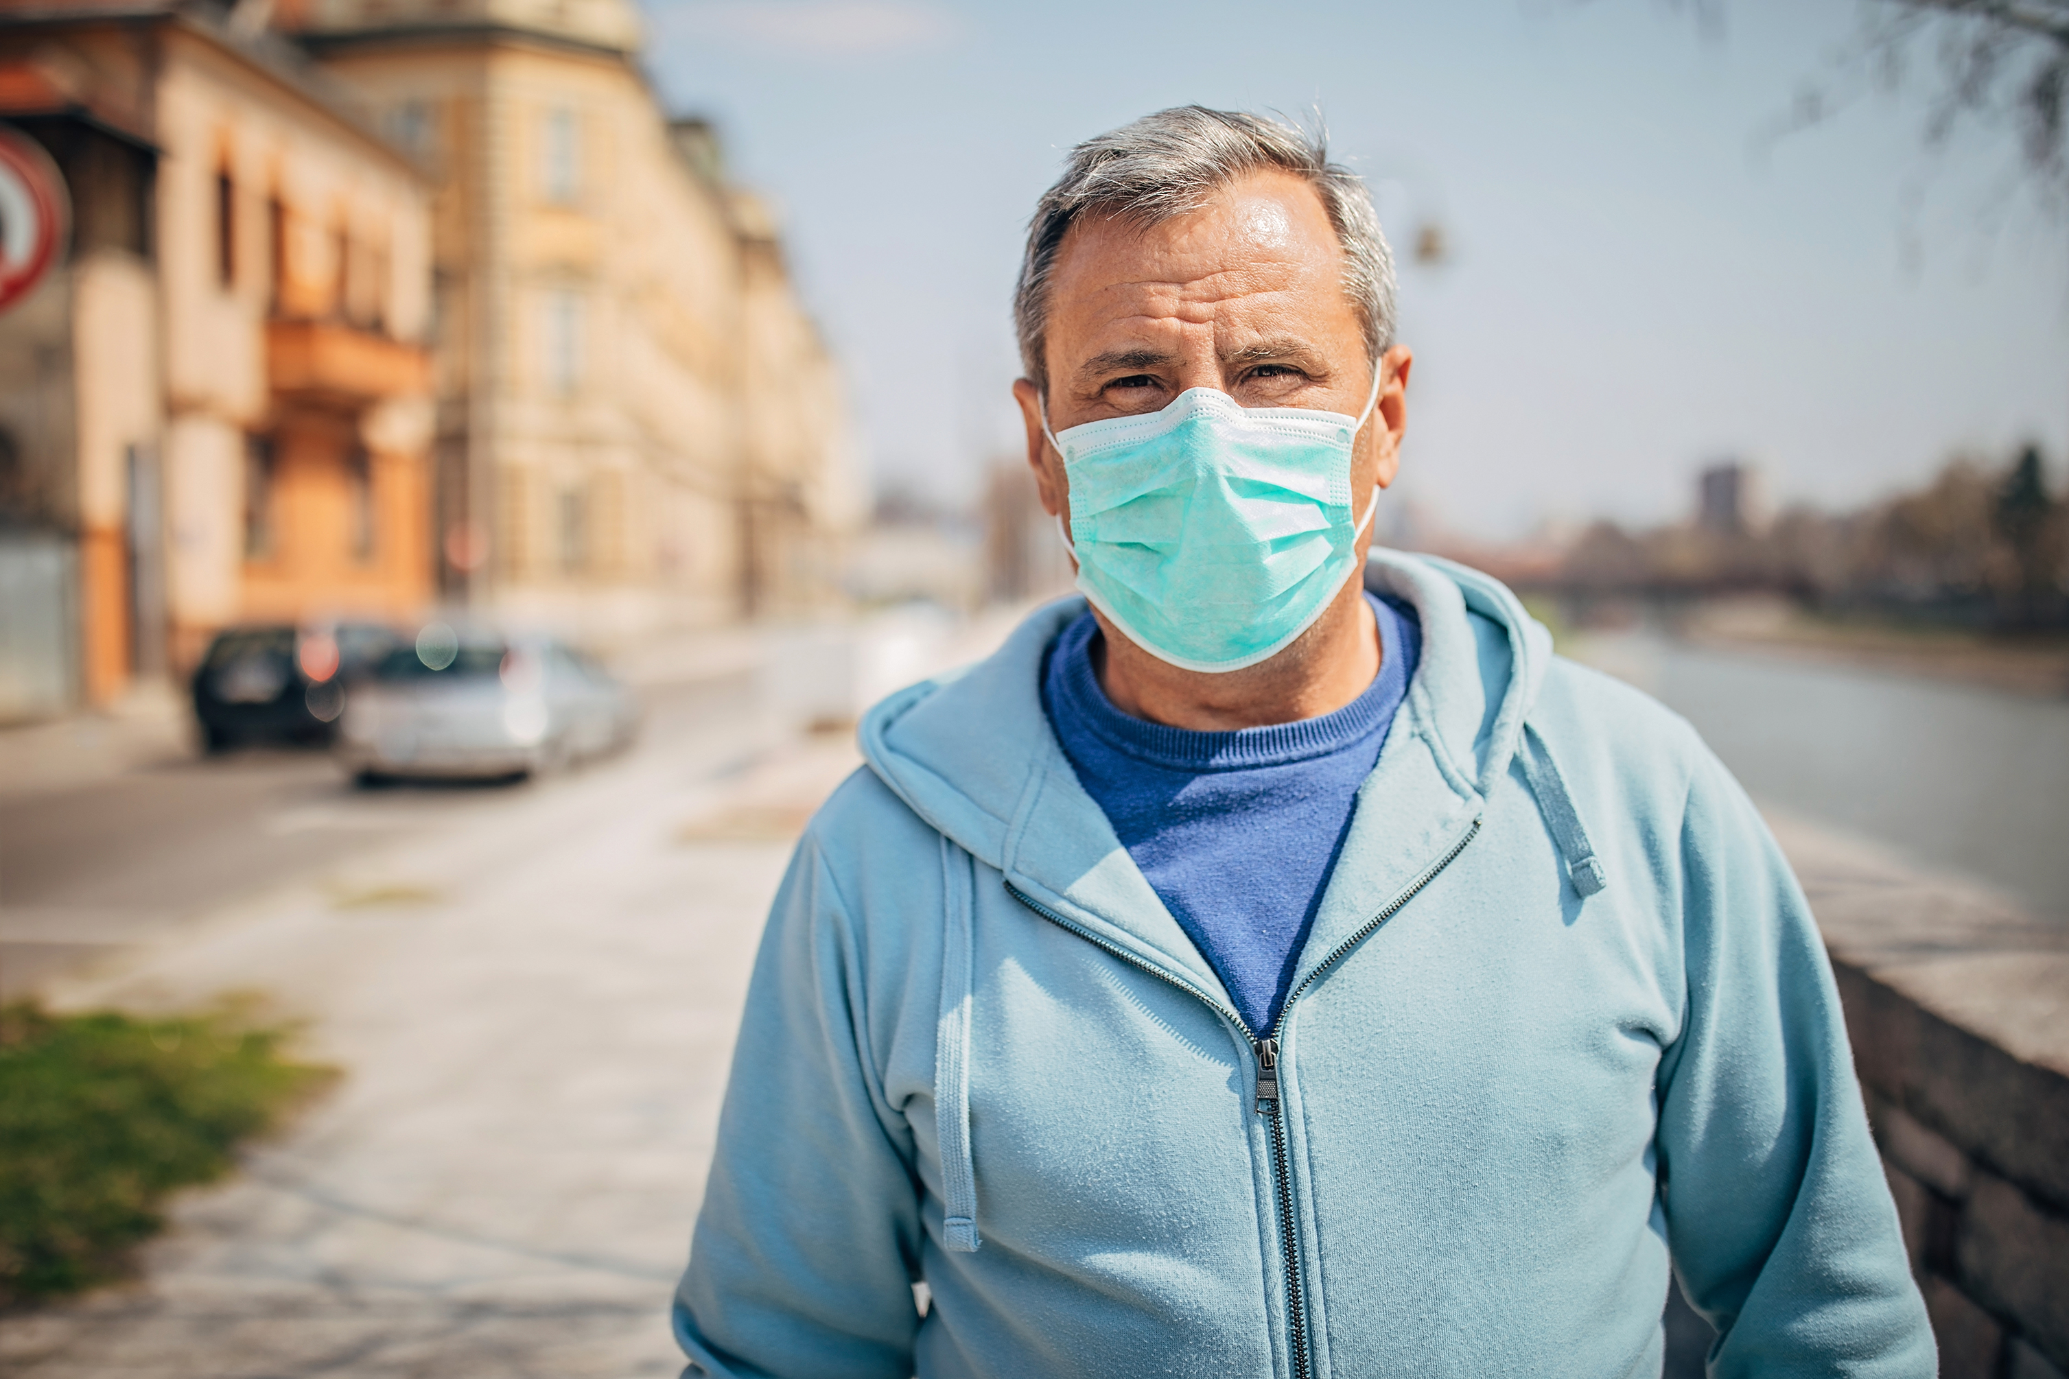


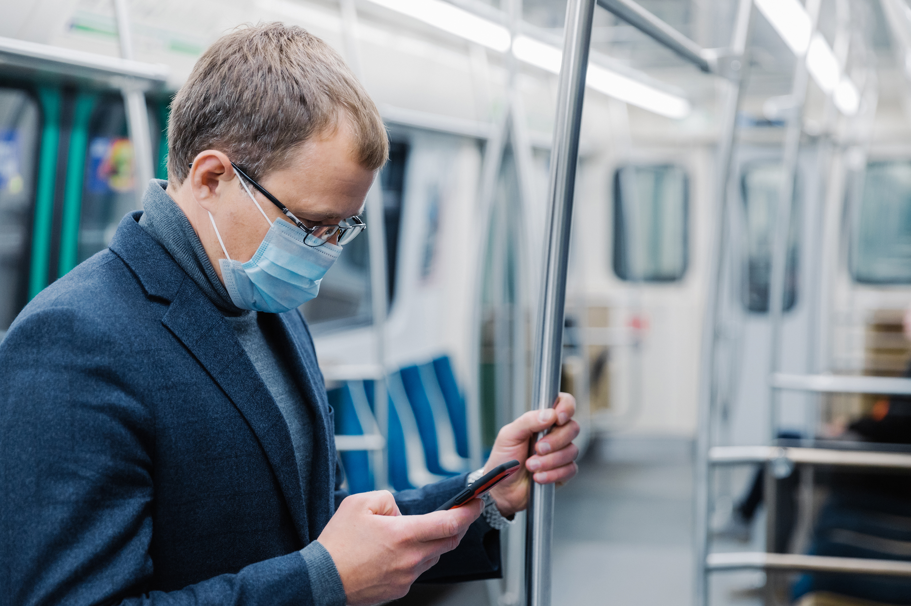


Teachers
Khalid Sir
Mahin Sir
Montu Sir
Mafuj Sir
Manik Sir

Slide 3

Our Compas

Slide 4

Md. Kader Molla
Principal
Of
KPB School And College

